Slide 1

HTML 5

Slide 2
Version Control and Revision History
 | Name | Date
Prepared By | Paranthaman | 02/01/2018
Reviewed By | Team
Approved By
Version No. | Date | Affected Sections | Highlights
1.0 |  | All | Updated according to the new template and course coverage

Slide 3
Objectives
After completing the session participants will able to
Develop Responsive Web Design (RWD).
Design and enhance using new form elements of HTML5.
Instruction to Develop and draw on the fly for different types of objects using Canvas API.

Slide 4
What is HTML5?
HTML5 is a markup language for structuring and presenting content for the World Wide Web (WWW).
HTML5 is a W3C specification that defines the fifth major revision of the Hypertext Markup Language (HTML).
Using HTML5 you can build Responsive Web Design (RWD).
HTML 5 is a combination of HTML,CSS and JS

Slide 5

Responsive Web Design
Responsive web design (RWD) is an approach to web design aimed at crafting sites to provide an optimal viewing experience.
Responsive web design makes your web page look good on all devices (desktops, tablets and mobiles).
Easy reading and navigation with a minimum of resizing, panning, and scrolling—across a wide range of devices (from desktop computer monitors to mobile phones).

Slide 6
Features in HTML5
New Semantic Elements: These are like <header>, <footer>, and <section>.
Forms 2.0: Improvements to HTML web forms where new attributes have been introduced for <input> tag.
Persistent Local Storage: To achieve without resorting to third-party plugins.
WebSocket : A a next-generation bidirectional communication technology for web applications.
Server-Sent Events: HTML5 introduces events which flow from web server to the web browsers and they are called Server-Sent Events (SSE).
Canvas: This supports a two-dimensional drawing surface that you can program with JavaScript.
Audio & Video: You can embed audio or video on your web pages without resorting to third-party plugins.
Geolocation: Now visitors can choose to share their physical location with your web application.
Drag and drop: Drag and drop the items from one location to another location on a the same webpage.
One of the most important features of HTML5 is that it is device independent.
HTML5 offers better error handling than previous HTML versions

Slide 7
HTML 5 Basics
Basic things should know in HTML
HTML Elements
HTML Attributes
HTML Headings
HTML Paragraphs
HTML Styles
HTML Formatting
HTML Quotations
HTML Comments
HTML Colors
HTML CSS
HTML Links
HTML Images
HTML Tables
HTML Lists

Slide 8
HTML 5 New Form Elements
Range
Url
Email
Tel
Number
Color
Date
Datalist
Search
These new features allow better input control and validation.
Not all major browsers support all the new form elements.
If they are not supported, they will behave as regular text fields.

Slide 9
HTML 5 Form Elements
<form action="" target="" method="">
First Name : <input type="text" name="firstName"<br>
Choose Car : <select name="cars" size="2" multiple>
<option value="volvo">Volvo</option><option value="saab">Saab</option>
<option value="fiat">Fiat</option><option value="audi">Audi</option>
</select>
<input list="browsers" name="browse"> <br><datalist id="browsers">
<option value="Internet Explorer"><option value="Firebox"><option value="Chrome">
<option value="Opera"><option value="Safari"> </datalist>
Gender : <input type="radio" name="gender" value="Male">Male
<input type="radio" name="gender" value="Female">Female<br>
Choose Vehicle <input type="checkbox" name="vehicle" value="Car">Car
<input type="checkbox" name="vehicle" value="Bike">Bike<br>
Choose Color :<input type="color" name="favcolor"><br>
Select DOB : <input type="date" name="bday" min="1979-12-31" max="2000-01-02">
Select Month of DOB : <input type="month" name="bdaymonth"><br>
Rating : <input type="number" name="quantity" min="1" max="5"><br>
Enter Email : <input type="email" name="email"><br>
Comments : <textarea name="message" rows="10" cols="30" style="width:200px;height:60px"><br>
Your Comments </textarea>
<input type="submit" value="Submit">
<input type="reset">
</form>

Slide 10
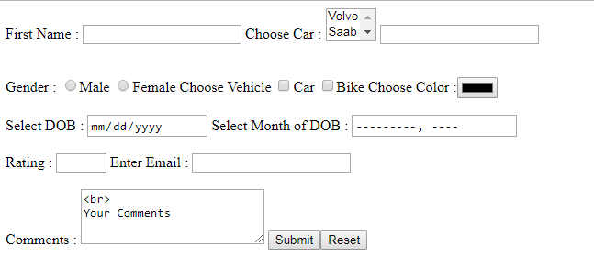
HTML Form Element output

Slide 11
HTML 5 Form Attributes
Input Restrictions
Here is a list of some common input restrictions (some are new in HTML5):
Attribute | Description
disabled | Specifies that an input field should be disabled
max | Specifies the maximum value for an input field
maxlength | Specifies the maximum number of character for an input field
min | Specifies the minimum value for an input field
pattern | Specifies a regular expression to check the input value against
readonly | Specifies that an input field is read only (cannot be changed)
required | Specifies that an input field is required (must be filled out)
size | Specifies the width (in characters) of an input field
step | Specifies the legal number intervals for an input field
value | Specifies the default value for an input field

Slide 12
HTML 5 Form Attribute
<html>
<head><title>HTML5 Form</title></head>
<body>
<form action="" autocomplete="on" >
First Name : <input type="text" name="firstName" value="Jhon"
readonly size="40" maxlength="10" autocus>
Last Name : <input type="text" name="lastName" value="Steve" disabled><br><br>
Middle Name : <input type="text" name="middleName" autocus>
<input type="image" src="img.jpg" alt="Submit" width="48" height="48"><br><br>
Country Code <input type="text" name="countryCode" pattern="[A-za-z]{3}"
title="Three letter Country Code" required>
Enter Pincode : <input type="text" name="pincode" placeholder="Enter Pincode" required><br><br>
Enter Age : <input type="number" name="points" step="3">
<input type="submit" value="Submit"><input type="reset">
</form>
</body>
</html>

Slide 13
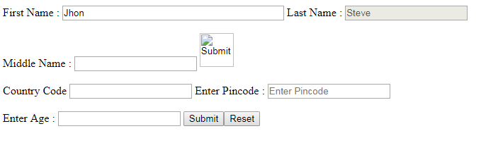
HTML Form Element output

Slide 14

HTML 5 Customize Validation Style
<form>
<label for="choose">Would you prefer a banana or cherry?</label>
<input id="choose" name="i_like" required>
<button>Submit</button>
</form>
input:invalid {
border: 2px dashed red;
}
input:valid {
border: 2px solid black;
}

Slide 15
HTML 5 Customized Error Message
Property | Description
validationMessage | A localized message describing the validation constraints that the control does not satisfy (if any), or the empty string if the control is not a candidate for constraint validation (willValidate is false), or the element's value satisfies its constraints.
validity | A ValidityState object describing the validity state of the element.
validity.customError | Returns true if the element has a custom error; false otherwise.
validity.patternMismatch | Returns true if the element's value doesn't match the provided pattern; false otherwise. If it returns true, the element will match the :invalid CSS pseudo-class.
validity.rangeOverflow | Returns true if the element's value is higher than the provided maximum; falseotherwise. If it returns true, the element will match the :invalid and :out-of-range and CSS pseudo-class.
validity.rangeUnderflow | Returns true if the element's value is lower than the provided minimum; false otherwise. If it returns true, the element will match the :invalid and :out-of-range CSS pseudo-class.

Slide 16
Get & Post type request
The default method when submitting form data is GET.
However, when GET is used, the submitted form data will be visible in the page address field:
/action_page.php?firstname=Mickey&lastname=Mouse
Notes on GET:
Appends form-data into the URL in name/value pairs
The length of a URL is limited (about 3000 characters)
Never use GET to send sensitive data! (will be visible in the URL)
Useful for form submissions where a user want to bookmark the result
GET is better for non-secure data, like query strings in Google
When to Use POST?
Always use POST if the form data contains sensitive or personal information. The POST method does not display the submitted form data in the page address field.
Notes on POST:
POST has no size limitations, and can be used to send large amounts of data.
Form submissions with POST cannot be bookmarked

Slide 17


Audio
HTML5 provides a standard for playing audio files.
To play an audio file in HTML, use the <audio> element.
The controls attribute adds audio controls, like play, pause, and volume.
Text between the <audio> and </audio> tags will display in browsers that do not support the <audio> element.
<audio controls>
<source src=“im.mp3" type="audio/mpeg"> </audio>

Slide 18


Video
HTML5 provides a standard for playing video files.
To play an video file in HTML, use the <video> element.
The controls attribute adds video controls, like play, pause, and volume.
It is a good idea to always include width and height attributes.
The effect will be that the page will change (or flicker) while the video loads.
<video width="320" height="240" controls>
<source src="movie.mp4" type="video/mp4">
</video>

Slide 19
Canvas
<canvas> tag is used to draw graphics, on the fly, via scripting (usually JavaScript).
<canvas> element has no drawing abilities of its own (it is only a container for graphics) - you must use a script to actually draw the graphics.
getContext() method returns an object that provides methods and properties for drawing on the canvas.
<canvas id="myCanvas" width="100" height="100">
</canvas>

Slide 20

Drawing a line
To draw a straight line on a canvas, you use these methods:
moveTo(x,y) defines the starting point of the line
lineTo(x,y) defines the ending point of the line
To actually draw the line, you must use one of the "ink" methods, like stroke().
<script type="text/javascript">
var canvas = document.getElementById("myCanvas");
var ctx = canvas.getContext("2d");
ctx.moveTo(0, 0);
ctx.lineTo(200, 100);
ctx.stroke();
</script>

Slide 21

Drawing a Circle
To draw a circle use arc() method.
Arc (x,y,r,start,stop) where x ,y are center of the circle, r is radius and start and stop are start and end points of a circle.
var canvas = docment.getElementById("myCanvas");
var ctx = canvas.getContext("2d");
ctx.beginPath();
ctx.arc(95,50,40,0,2*Math.PI);
ctx.stroke();

Slide 22

Drawing a text
To draw text on a canvas, the most important property and methods are:
font - defines the font properties for the text.
strokeText(text,x,y) - Draws text on the canvas.
fillText(text,x,y) - Draws "filled" text on the canvas.
var canvas = document.getElementById("myCanvas");
var ctx = canvas.getContext("2d");
ctx.font = "20px Arial";
ctx.strokeText("Hello World",10,50);

